Slide 1



C Programming in ATMs
Name |  | PRN
Arun S | - | 1262250907
Abhinav Chavan | - | 1262251966
Himanshu Zore | - | 1262254106
Krishnanunni Kurup | - | 1262250827
Declan Po | - | 1262250688
Faculty Name: Anuradha Nagare

Slide 2

INTRODUCTION
Automated Teller Machines (ATMs) are real-time embedded systems that perform secure banking operations such as cash withdrawal, balance enquiry, and deposits.
C programming is widely used in ATMs because it is efficient, reliable, and close to hardware. Using control structures like if-else, loops, and switch-case, C programs handle user authentication, transaction processing, and error handling.
Thus, C programming plays a crucial role in the smooth and safe functioning of ATMs.

Slide 3

ATM WITHDRAWAL PROCESS
Card Insertion and Reading
Printing Transaction Receipt
Selecting Deposit or Withdrawal
01
03
05
PIN Authentication
Cash Dispensing Mechanism
02
04

Slide 4
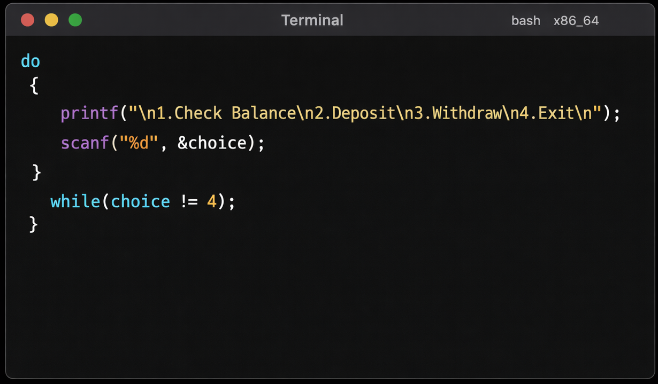
CARD INSERTION AND READING
➡ USED TO DISPLAY THE ATM MENU REPEATEDLY UNTIL THE USER SELECTS EXIT.
➡USES DO-WHILE LOOP.

Slide 5
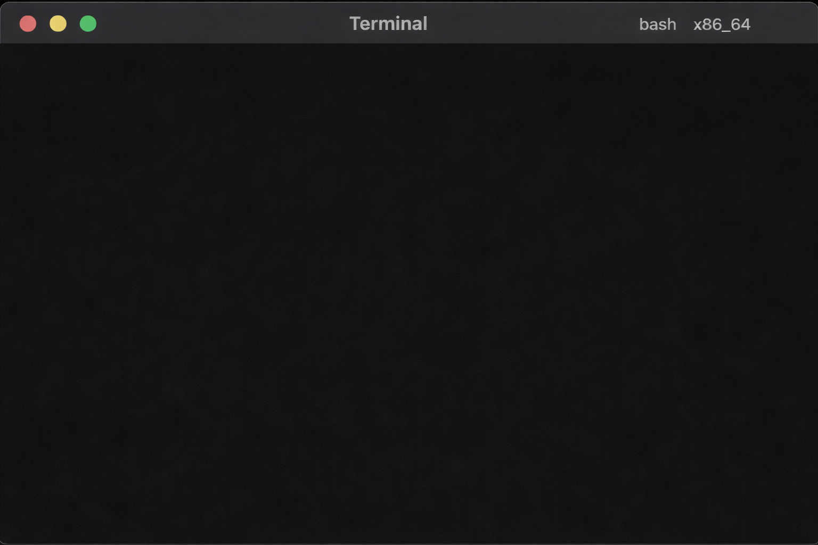
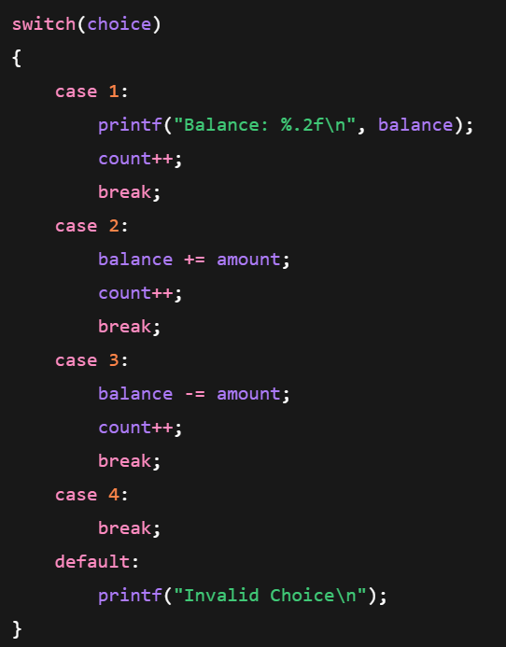
➡ USED TO SELECT DIFFERENT ATM OPERATIONS SUCH AS BALANCE CHECK, DEPOSIT, WITHDRAWAL, AND EXIT.
➡USES SWITCH CASE.

Slide 6
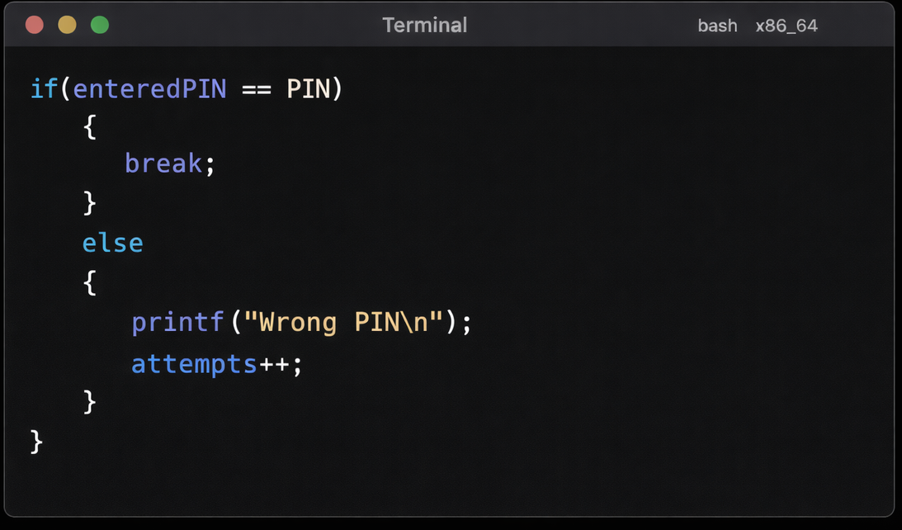
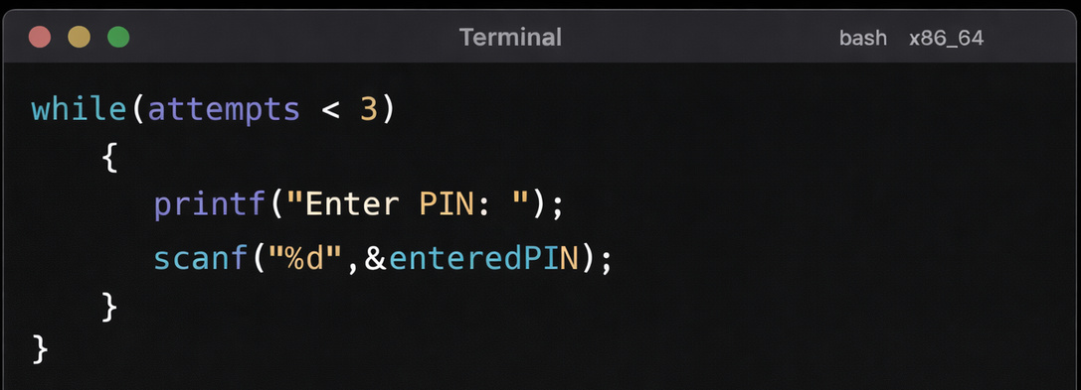
PIN AUTHENTICATION
➡ USED TO verify the entered PIN and allow access only if it is correct.
➡USES IF-ELSE STATEMENT.
➡ USED TO LIMIT THE NUMBER OF PIN ATTEMPTS TO 3.

Slide 7
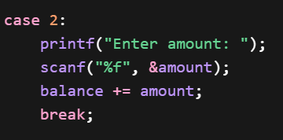
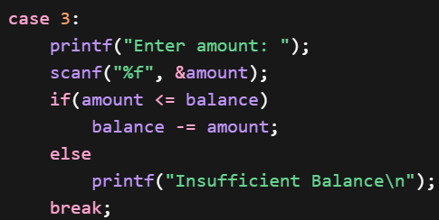
DEPOSIT & WITHDRAWAL
➡ USES If-Else TO CHECK SUFFICIENT BALANCE BEFORE WITHDRAWING MONEY.
➡ SUBTRACTS THE WITHDRAWN MONEY FROM BALANCE
➡ ADDS MONEY TO THE BALANCE

Slide 8
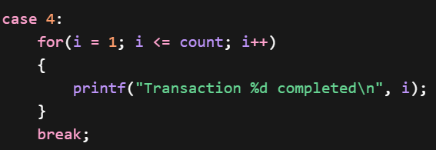
TRANSACTION RECEIPT
➡ USED TO DISPLAY THE NUMBER OF COMPLETED TRANSACTIONS AS A RECEIPT.
➡ USES FOR LOOP

Slide 9
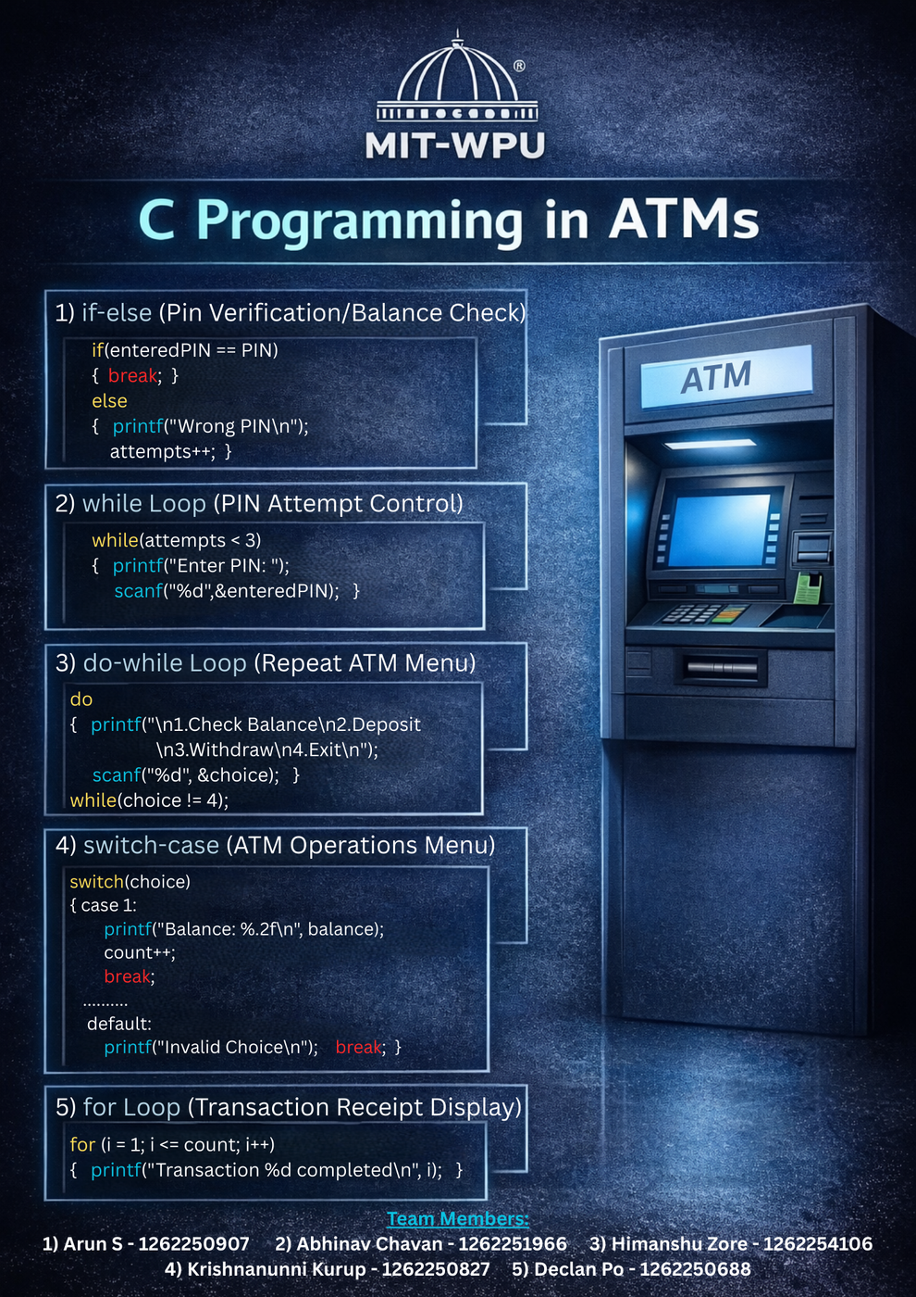

Slide 10

THANK YOU!

